Slide 1

2016 Customers Meeting

Slide 2
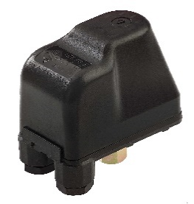
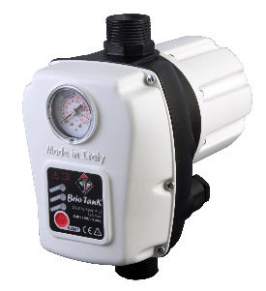
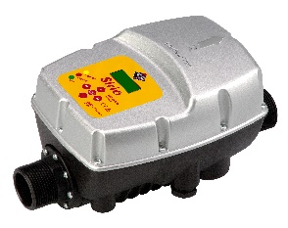
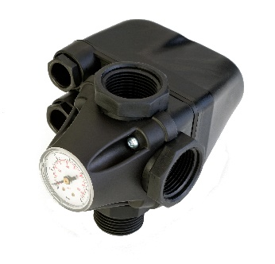
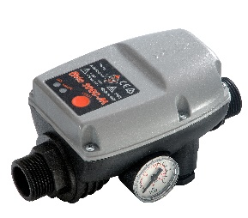
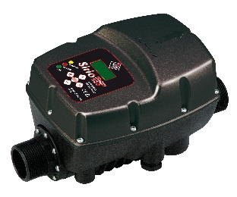
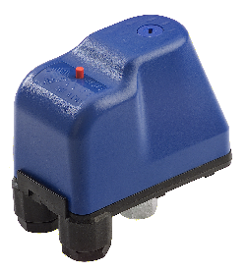
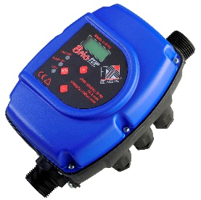
PRODUCTS OVERVIEW
Electronic controllers for water pumps
Variable frequency drivers for water pumps
Pressure switches for water pumps

Slide 3
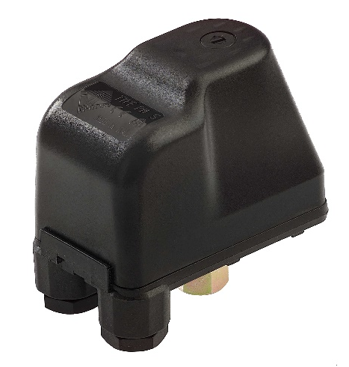
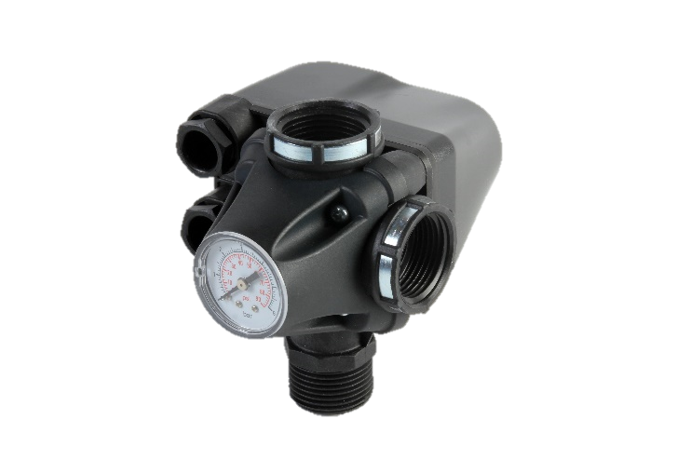

PRESSURE SWITCHES FOR WATER PUMPS
PM-PT
PM/5-3W PT/5-3W
LP/3
MODEL | RANGE | RATINGS
PM/5 | 1-5 bar | 250V 16(10A)
PM/6 | 1,5-5,5 bar | 250V 16(10A)
PM/12 | 3-12 bar | 250V 16(10A)
PT/5 | 1-5 bar | 500V 16(10A)
PT/6 | 1,5-5,5 bar | 500V 16(10A)
PT/12 | 3-12 bar | 500V 16(10A)
MODEL | RANGE | RATINGS
PM/5-3W | 1-5 bar | 250V 16(10A)
PT5-3W | 1-5 bar | 500V 16(10A)
MODEL | RANGE | RATINGS
LP/3 | 0,05-0,4 bar | 250V 16(10A)
LP/3-18 | 0,5-2,0 bar | 250V 16(10A)

Slide 4
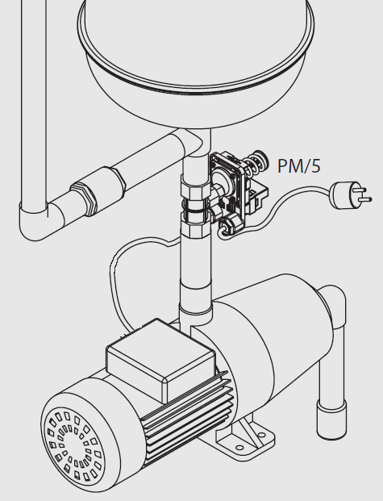
APPLICATIONS
PM/5-3W

Slide 5
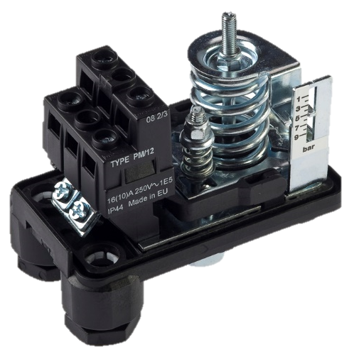
ADVANTAGES
FULLY INSULATED TERMINALS
IMPROVED SAFETY
DIFFERENT SETTINGS AVAILABLE
CAN BE USED IN VARIOUS SYSTEMS WITH DIFFERENT PUMPS
GRADUATED SCALE
EASY SETTING OF PRESSURE
TEAR-RESISTANT CABLE CLAMPS
REVOLVING NUT
IMPROVED SAFETY
QUICK CONNECTION

Slide 6
ELECTRONIC CONTROLLERS FOR WATER PUMPS
BRIO 2000-M
BRIO TANK
BRIO TOP
Pressure and flow controller
Supply | 230V 50-60Hz 12A max.
Pressure and flow controller with embedded pressure tank
Supply | 230V 50-60Hz 12A max.
Pressure and flow controller with display and advanced features
Supply | 230V 50-60Hz 16A max.

Slide 7
APPLICATIONS
IRRIGATION
DOMESTIC WATER SYSTEMS
INDUSTRIAL
RESIDENTIAL

Slide 8
ADVANTAGES
ADJUSTABLE CUT-IN PRESSURE
COMPACT DESIGN
ONE UNIQUE MODEL CAN BE USED UP TO 35m HEIGHT
CAN BE INSTALLED EVERYWHERE
IN VERTICAL OR HORIZONTAL POSITION
MAXIMUM LOAD 12A
CAN BE USED WITH PUMPS UP TO 2HP
AUTOMATIC RESET
PUMP RESTART AUTOMATICALLY AFTER DRY RUNNING
RATED IP65
CAN BE INSTALLED OUTDOOR WITHOUT ADDITIONAL PROTECTION
INTEGRATED PRESSURE GAUGE
VERY LOW PRESSURE DROP
NO NEED OF EXTERNAL ACCESSORIES
DOESN’T AFFECT PUMP PERFORMANCE

Slide 9
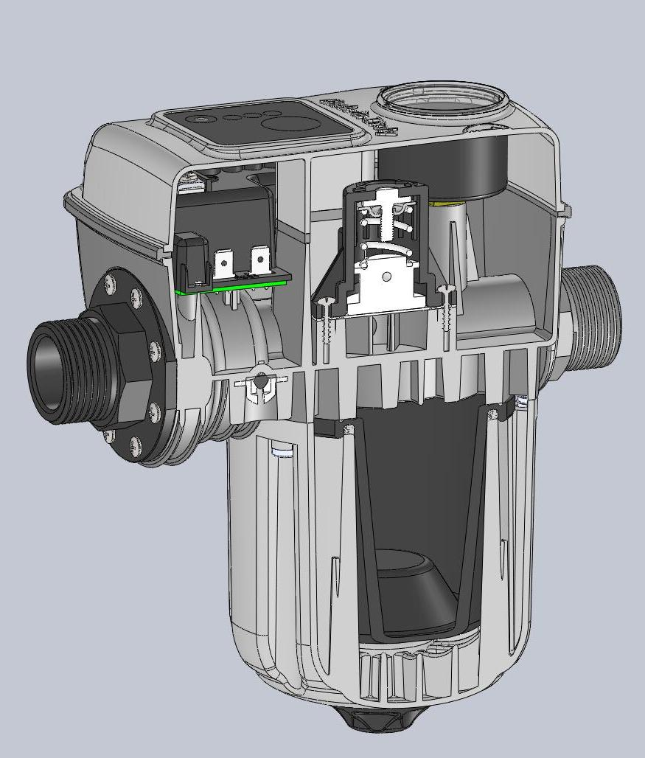
BRIO TANK
0,4LT INTEGRATED PRESSURE TANK WITH EPDM BLADDER
INSPECTIONABLE VALVE
REDUCES HAMMERING
REDUCES RESTARTS OF THE PUMP
HELPS TO STABILIZE PRESSURE IN THE SYSTEM WHEN THE PUMP STOPS
VALVE CAN BE CLEANED FROM IRON AND SAND
LOW STAND-BY POWER
PRE-CHARGE PRESSURE VALVE
ELECTRONIC BOARD IS COLD AND AVOID CONDENSATION
PRE-CHARGE PRESSURE CAN BE INSPECTED AND CHANGED
OPTIONAL PRESSURE GAUGE HELPS TO VERIFY INTERNAL PRESSURE.

Slide 10
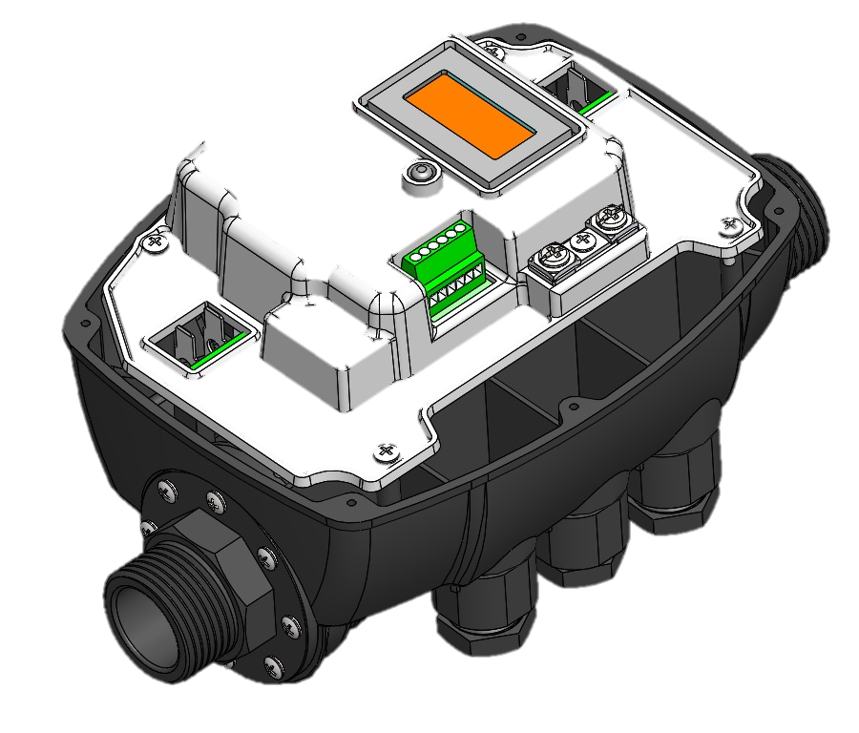
BRIO TOP
5 LANGUAGES LCD
EASY SETTING OF PARAMETERS
DIGITAL INDICATION OF PRESSURE AND CURRENT
RATED 16A
CAN BE USED WITH PUMPS UP TO 3HP
CURRENT CONTROL
PROTECTS THE PUMP AGAINST OVERLOAD
I/O CONNECTIONS
CAN BE CONNECTED TO BMS AND OTHER EQUIPMENTS FOR REMOTE CONTROL
ALLOWS CONNECTION OF 2 DEVICES IN BOOSTER SETS
ERROR LOG
ERROR LOGGING FOR AN EASIER AND COMPLETE TROUBLESHOOTING

Slide 11
WHY TO CHOOSE BRIO TOP ?
2 PRODUCTS IN ONE!
Mode
P + F
Mode
P + P
P+F MODE
P+P MODE
PUMP STARTS ON PRESSURE DROP AND STOPS ON ZERO FLOW
NO NEED OF PRESSURE TANK
MAXIMUM PRESSURE CANNOT BE ADJUSTED
PUMP STARTS AND STOPS ACCORDING TO PRESSURE THRESHOLD
MUST BE USED WITH A PRESSURE TANK, LIKE A PRESSURE SWITCH
CUT-IN AND CUT-OFF PRESSURE CAN BE REGULATED

Slide 12
WHY TO CHOOSE BRIO TOP ?
BOOSTER SETS WITHOUT CONTROL BOX!
P+P MODE
WHEN USED IN P+P MODE WITH A PRESSURE TANK, 2 DEVICES CAN BE INTERCONNECTED TO GET A BOOSTER SET
PUMPS START IN SWAPPED MODE ON WATER DEMAND
PUMPS CAN RUN TOGETHER IN CASE OF HIGH WATER REQUEST FROM THE USERS
JUST A 4 WIRE CABLE IS NEEDED FOR INTERCONNECTION

Slide 13
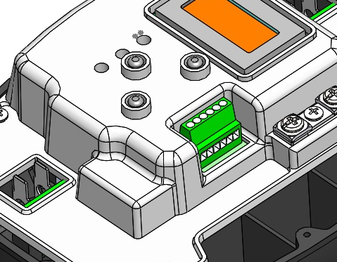
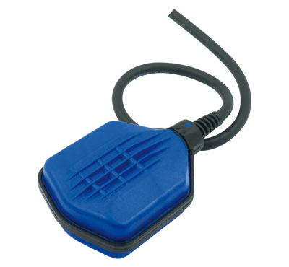
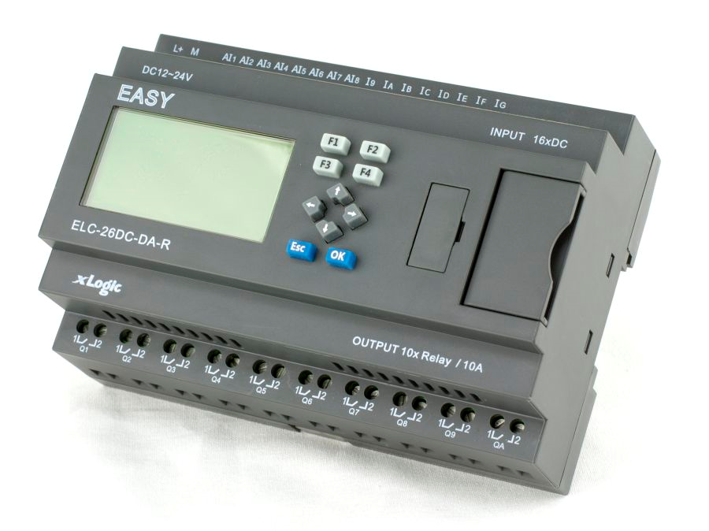
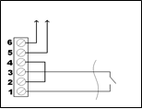

WHY TO CHOOSE BRIO TOP ?
CAN BE CONNECTED TO OTHER DEVICES
AUXILIARY I/O
INPUT CAN BE USED TO CONNECT A FLOAT SWITCH OR A TIMER
CAN BE REMOTELY OPERATED FROM ANOTHER DEVICE (PLC, COMPUTER WITH “CAFM”, ETC.)
OUTPUT RELAY CAN SIGNAL ERROR CONDITIONS OR CAN BE USED TO START OTHER EQUIPMENT (UV UNITS, CHLORINE PUMPS, ETC.)
CAN BE USED TO INTERFACE THE PUMP TO BMS (BUILDING MANAGEMENT SYSTEMS)

Slide 14


WHY TO CHOOSE BRIO TOP ??
ADVANCED PROTECTIONS AND FEATURES
OVER CURRENT
Stops the pump when the current overcomes the maximum programmed value (locked rotor)
ICE PROTECTION
If temperature falls below 4°C, pump starts automatically for 15” every 15 minutes to prevent freezing of water inside the impellers
OVER PRESSURE
Stops the pump when the pressure overcomes the maximum programmed value (useful for applications with variable suction depth)
ANTI-SEIZE FUNCTION
When the pump is not used for a period longer than 24H, Brio Top will start the motor automatically to prevent rotor seizure

Slide 15
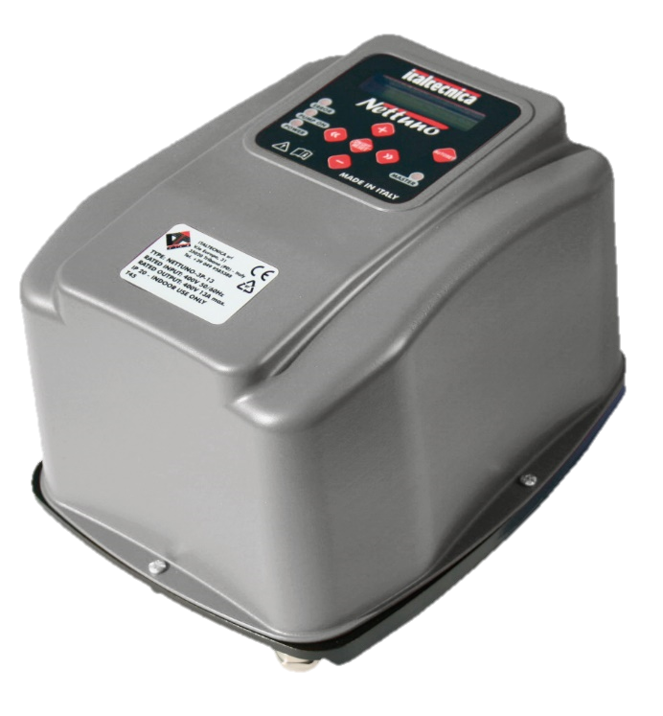
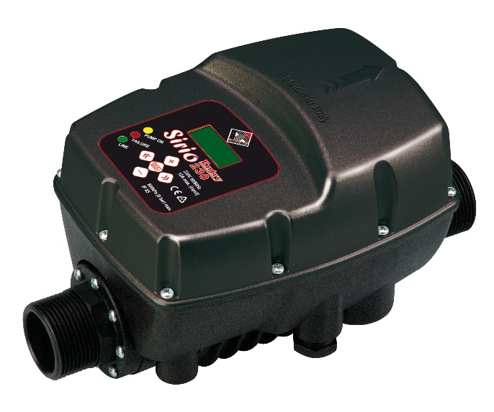

INVERTERS FOR WATER PUMPS
SIRIO
SIRIO ENTRY – SIRIO ENTRY XP
NETTUNO
1-PH 230V INPUT / 3-PH 230V OUTPUT
For 3-phase pumps, delta connection, Output max. 9,7A
Water cooling – pipe mounting
1-PH 230V INPUT / 1-PH 230V OUTPUT
For 1-phase pumps with capacitor, Output max. 10,5A Sirio Entry Output max. 14A Sirio Entry XP
Water cooling – pipe mounting
3-PH 400V INPUT / 3-PH 400V OUTPUT
For 3-phase pumps, star connection, Output max. 13A Output max. 9A Output max. 6A
Air cooling – wall mounting

Slide 16
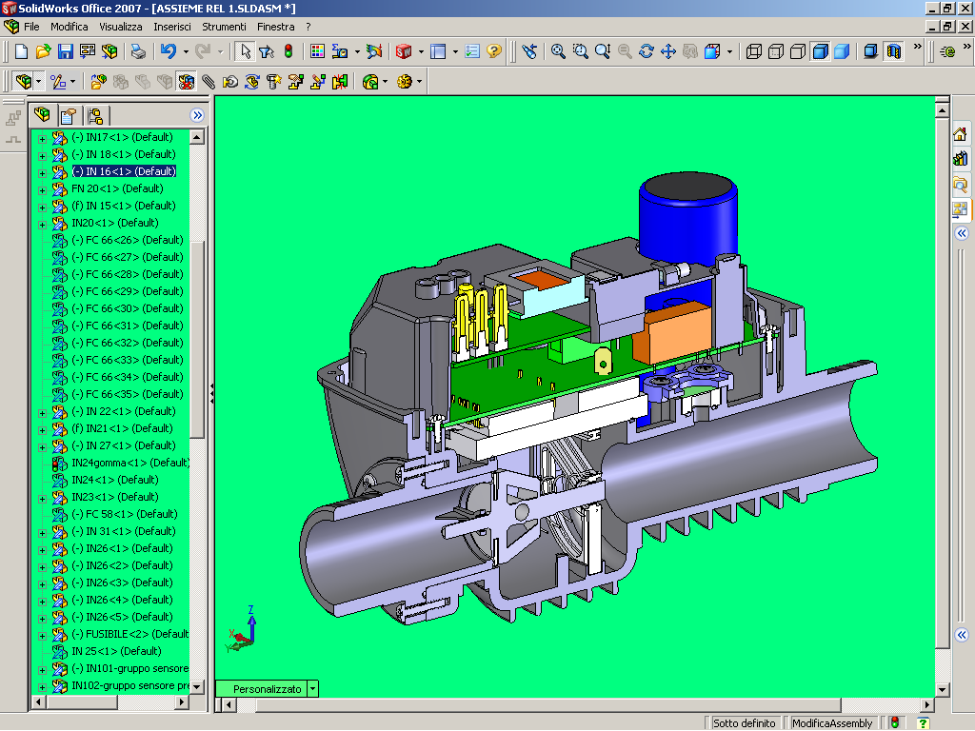
ADVANTAGES
VARIABLE SPEED
8 LANGUAGES LCD
EASY SETTING OF PARAMETERS
DIGITAL INDICATION OF PRESSURE AND CURRENT
ERROR LOG
CONSTANT PRESSURE AND ENERGY SAVING
COMPACT DESIGN
CAN BE INSTALLED EVERYWHERE
IN VERTICAL OR HORIZONTAL POSITION
WATER COOLING
INTEGRATED PRESSURE SENSOR
LONG LIFE OF POWER ELECTRONIC CIRCUITS,
HIGH POWER RATINGS IN A SMALL DESIGN
NO NEED OF EXTERNAL SENSOR
NO EXTRA COSTS

Slide 17
WHAT IS NEW ON SIRIO 2.0?
User friendly new interface:
3.0 BAR
40 Hz
Vin= 230V
I= 6.0A
Tm=45°C
Ta=45°C
Language
EN
All functioning variables available on the LCD (pressure, voltage, temperature)
End user can only change the language (to prevent unauthorized variation of parameters)

Slide 18
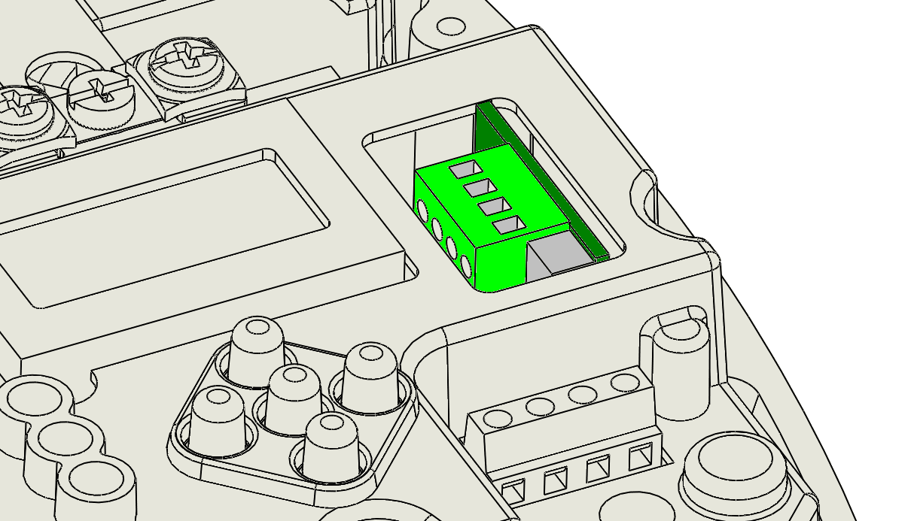
WHAT IS NEW ON SIRIO 2.0?
Optional I/O card:
1 digital input for external start, external error or double set-point
1 digital output for “error” signaling, “pump in function” signaling or for auxiliary fixed speed pump
Improved I/O:
I/O input
‘2’ ←
I/O output
ERR.
Standard Aux. Connector: allows the connection of 2 Sirio in a booster set; otherwise can be used for external start or double set-point command
Aux. Con.
1 <->

Slide 19
WHAT IS NEW ON SIRIO 2.0?
Intelligent thermal management:
automatically reduces the power to the pump when the temperature increases
avoids over-temperature on the IGBT and DC bus capacitors
extends inverter life
T.a. max
80°C

Slide 20
WHAT IS NEW ON SIRIO 2.0?
Improved pressure sensor amplification circuit:
improved pressure reading
reduced drift of the signal along the time
increased amplification gain for a more accurate pressure reading
Pr. Calibr.
0.0 BAR
Pr. Calibr.
5.0 BAR

Slide 21
WHAT IS NEW ON SIRIO 2.0?
Complete error log:
E0 (000)
Low Voltage
E1 (000)
High voltage
E6 (000)
Dry Running
Complete error log
13 different error codes with full text explanation
Value between brackets indicates number of occurrences for one error
Timer of “power supply time” and “pump running time”
E13 (000)
Press.Sens.

Slide 22

WHAT IS NEW ON SIRIO 2.0?
Can operate with impure water:
Flow sensor can be disabled
The drive can be operated according only to the pressure
Useful for application with sand and iron
Dry running pressure must be set to correctly stop the pump in absence of water
Flow sens.
OFF
Dry ru. Press.
0,5 BAR

Slide 23
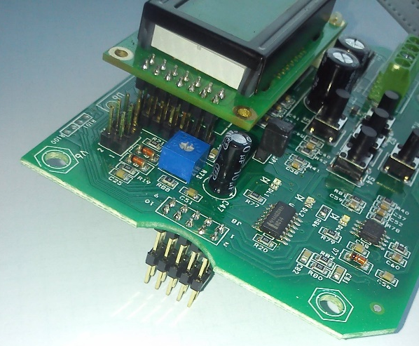
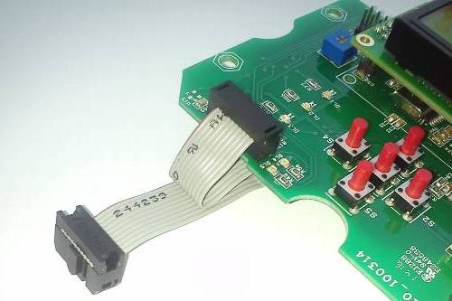


WHAT IS NEW ON SIRIO 2.0?
New board to board connection:
Boards are internally connected through ribbon flat cable instead of pin strips
Increased reliability
No loose of signal
Easier replacement of the boards during service

Slide 24
WHAT IS NEW ON SIRIO 2.0?
New configuration possibilities:
DeltaP stop: when the actual pressure overcomes the value of “set-point+deltaP stop” the drive will stop the pump immediately, without delay.
DeltaP Stop
2.0 BAR
Additionally to the dry running automatic reset, a full reset function can be enabled to automatically restart the pump after any error (under voltage, over voltage, over temperature, etc.)
Full reset
ON

Slide 25
WHAT IS NEW ON SIRIO 2.0?
Rated frequency: the maximum rated frequency of the pump can be selected between 50 and 60 Hz
Nom.Freq.
50 Hz
Frequency correction: allows to apply a correction to the rated frequency from -5 up to +5 Hz. Can be used to limit or to extend the power of the pump.
Freq. Corr.
+5 Hz

Slide 26
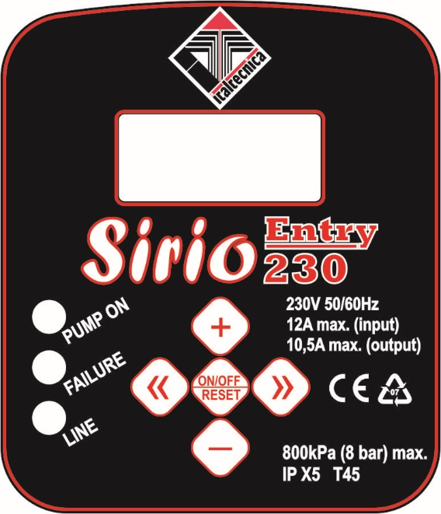

WHAT IS NEW ON SIRIO 2.0?
Functioning mode can be changed between AUTOMATIC (pressure) or MANUAL.
Manual mode allows to test the pump at different frequencies, without the closed-loop pressure control.
Command
MAN
2.0 BAR
55 Hz

Slide 27
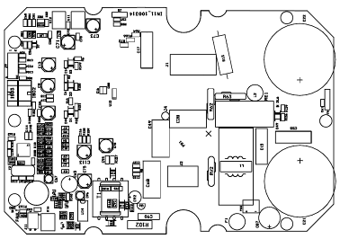
WHAT IS NEW ON SIRIO 2.0?
More than 20 improvements were applied to the circuit boards:

Slide 28

WHAT IS COMING ON??
Nettuno
 | INPUT | OUTPUT
NETTUNO 3P 13A | 3X400V | 3X400V – 13A max.
NETTUNO 3P 9A | 3X400V | 3X400V – 9A max.
NETTUNO 3P 6A | 3X400V | 3X400V – 6A max.
Nettuno Universal
 | INPUT | OUTPUT
NETTUNO UNIVERSAL | 1X230V | 1X230V – 10,5A max. 3X230V – 9,7A max. (selectable)

Slide 29
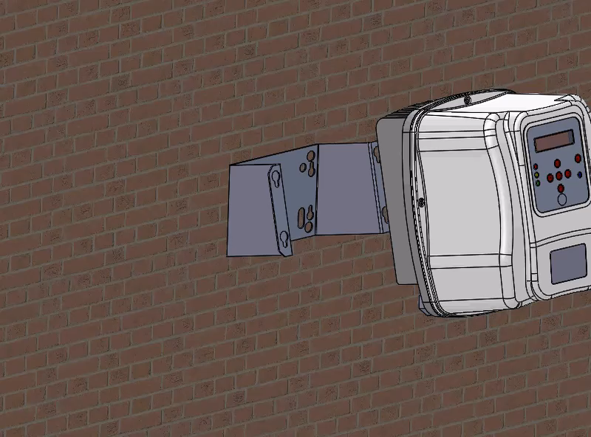
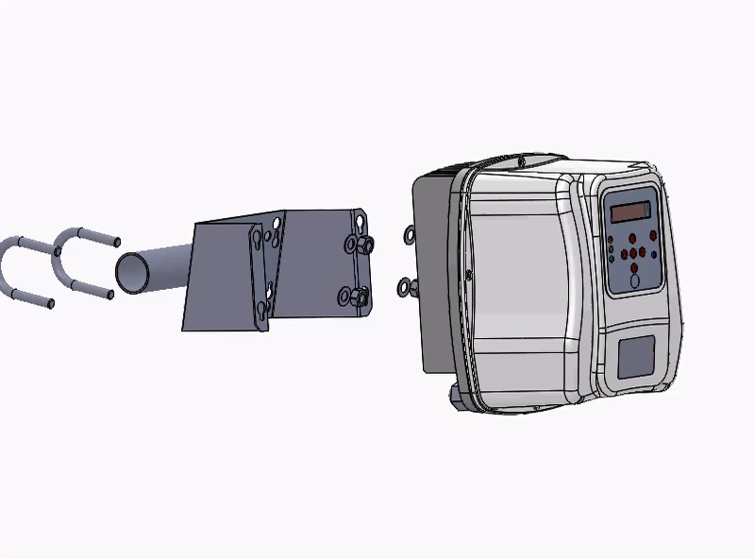
NETTUNO
Wall mounting
Pipe mounting

Slide 30
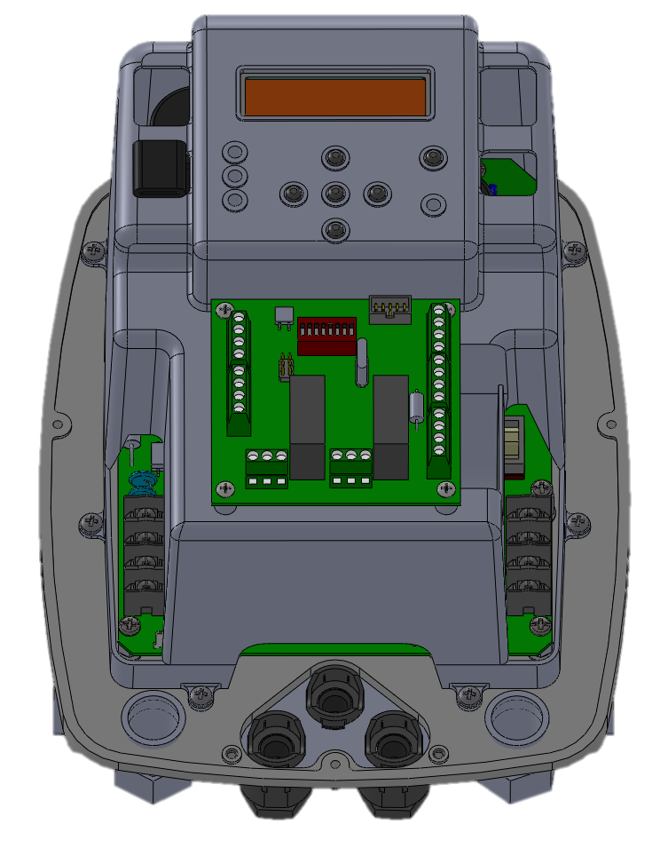
NETTUNO
DIGITAL INPUTS
DISPLAY
1X ENABLE
1X ERROR
1X SECONDARY SET-POINT
LCD 16X2 – EASY CONFIGURATION
ANALOG INPUTS
4-20mA (TRANSDUCER)
0-10V (AUXILIARY)
POWER OUTPUT
400V – 3 MODELS AVAILABLE FOR 6, 9 AND 13 A MAX. LOAD
POWER INPUT
400V – 50/60Hz
RS 485
DIGITAL OUTPUTS
UP TO 8 PUMPS CONNECTED ON BOOSTER SET
2X OUTPUTS (ERROR, PUMP ON, DOL PUMP)

Slide 31
THANKS FOR YOUR ATTENTION!

